Slide 1
Getting closer to desired destination
Stream - CsE
sec - b
Group number- 04
Prepared by:
Anurag ganguly(13000117125)
Anupam chakraborty(13000117126)
Aniket das(13000117130)
Ananya paul(13000117131)

Slide 2
Project Statement
You want to go to place, say IIT Madras. You have no idea how IITM is connected to your current location.
You do know that going to the airport will get you closer to your destination. So you go to the airport. Your current location has been changed.
You now look for another place to go to which will get you closer to IITM. The airplane seat seems like a good place.
For any current location, we try to find a place X such that it gets us closer to our destination. We do this till we end up at our destination. Apply a design technique to solve the problem.

Slide 3
Abstract/Scope
We want to go to a particular destination from our current location.
So, we start to find a place that will take us closer to our destination and we move there. Now, our location changes and again, we repeat the process.
We stop, once we reach our destination.
These kind of problems are relatable in real life scenarios which may include any kind of travelling.

Slide 4
PROJECT REQUIREMENTS
We need to find out a suitable design technique to be applied to the problem at hand.
A correct algorithm will not only solve the problem, but also, reduce the time complexity.
We need to have an IDE(integrated development environment) for example Dev C++ or Codeblocks for executing the program.
GNU Compiler Collection should be installed in the system.

Slide 5
Logic
Shortest distance from every vertex to the destination node has been stored in an array.
dijkstra1 function calculates and returns the shortest distance from a node to destination.
dijkstra function finds out the closest node to the destination with the help of the aforementioned array.
A boolean array of size equals to the number of vertices(initialised to false) has been used which updates whenever we reach our suitable node to true.
Finally printing the nodes according to the boolean array, whenever we encounter true we print corresponding node.

Slide 6
An integer array(nds[]) is used which stores the path or the sequence of the suitable nodes.
When temp(temporary variables storing the vertex) is equals to 9999 then no other suitable vertex(place) is possible.
Thus the next stop is our destination, hence we update nds[i] with the destination and breaks out from the loop.
Finally nds[] contains the path which is being printed.

Slide 7
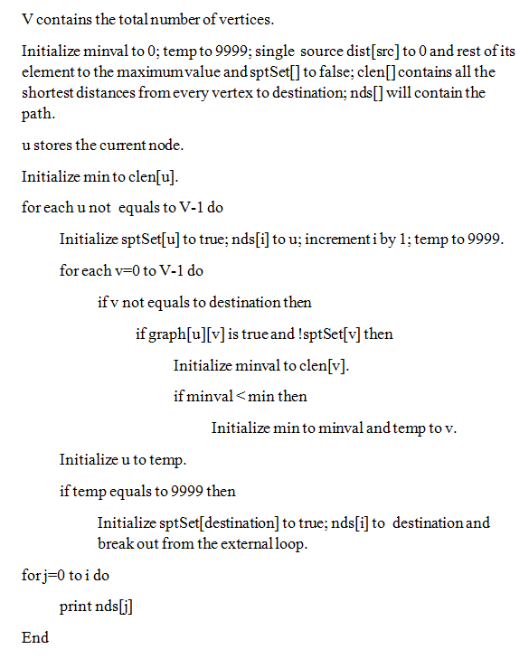
Pseudo code

Slide 8
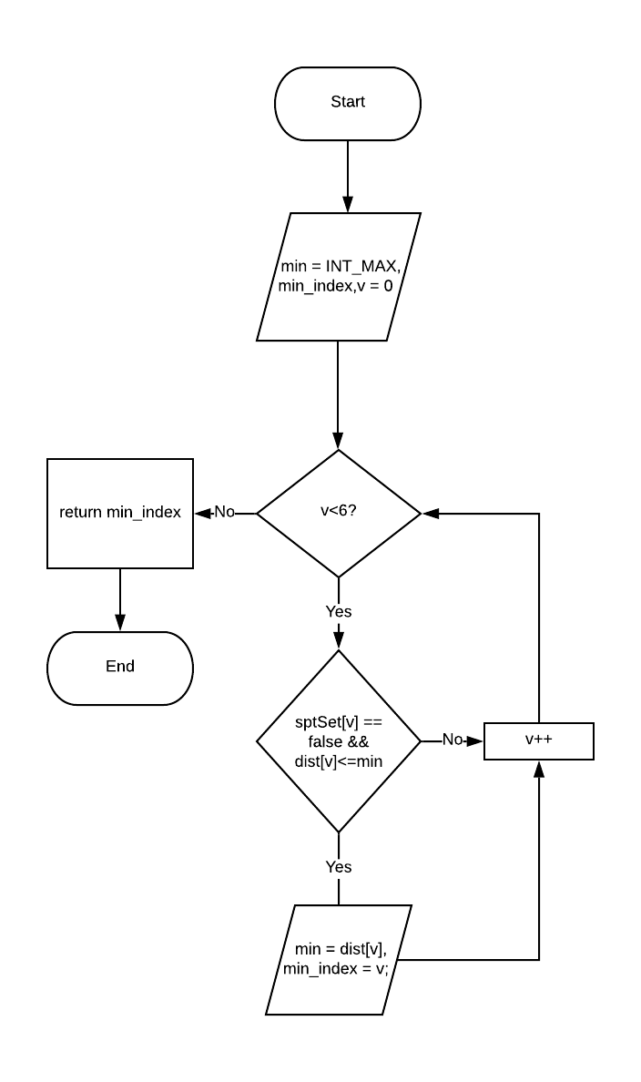
Design of the solution using flowchart
int minDistance(int dist[], bool sptSet[])

Slide 9
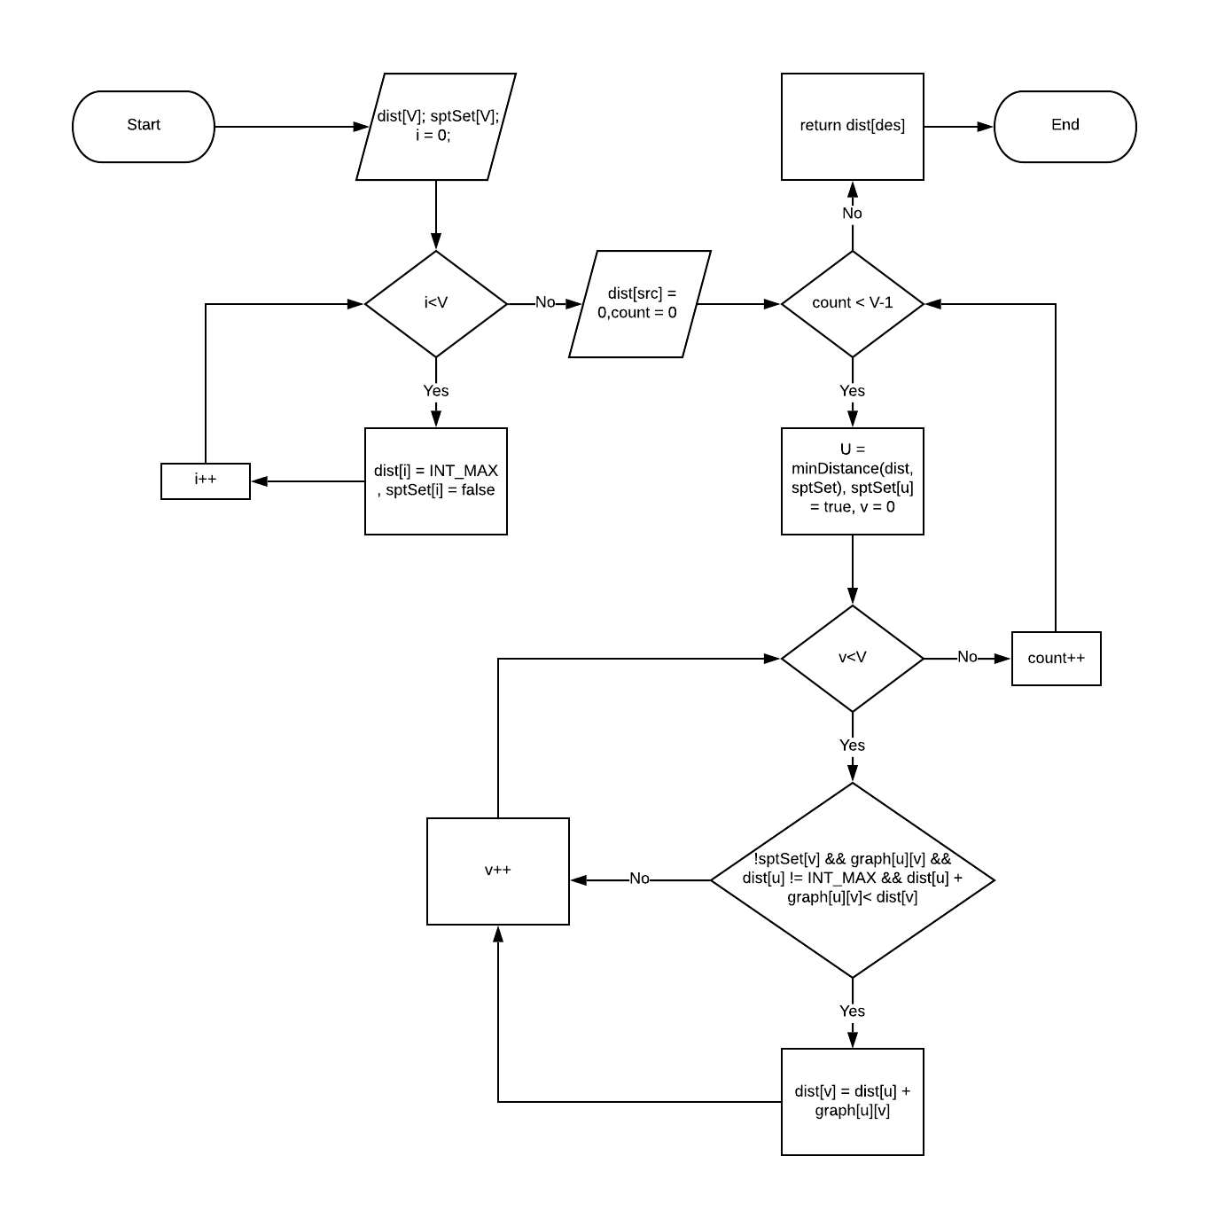
int dijkstra( int graph[V][V], int src, int des)

Slide 10
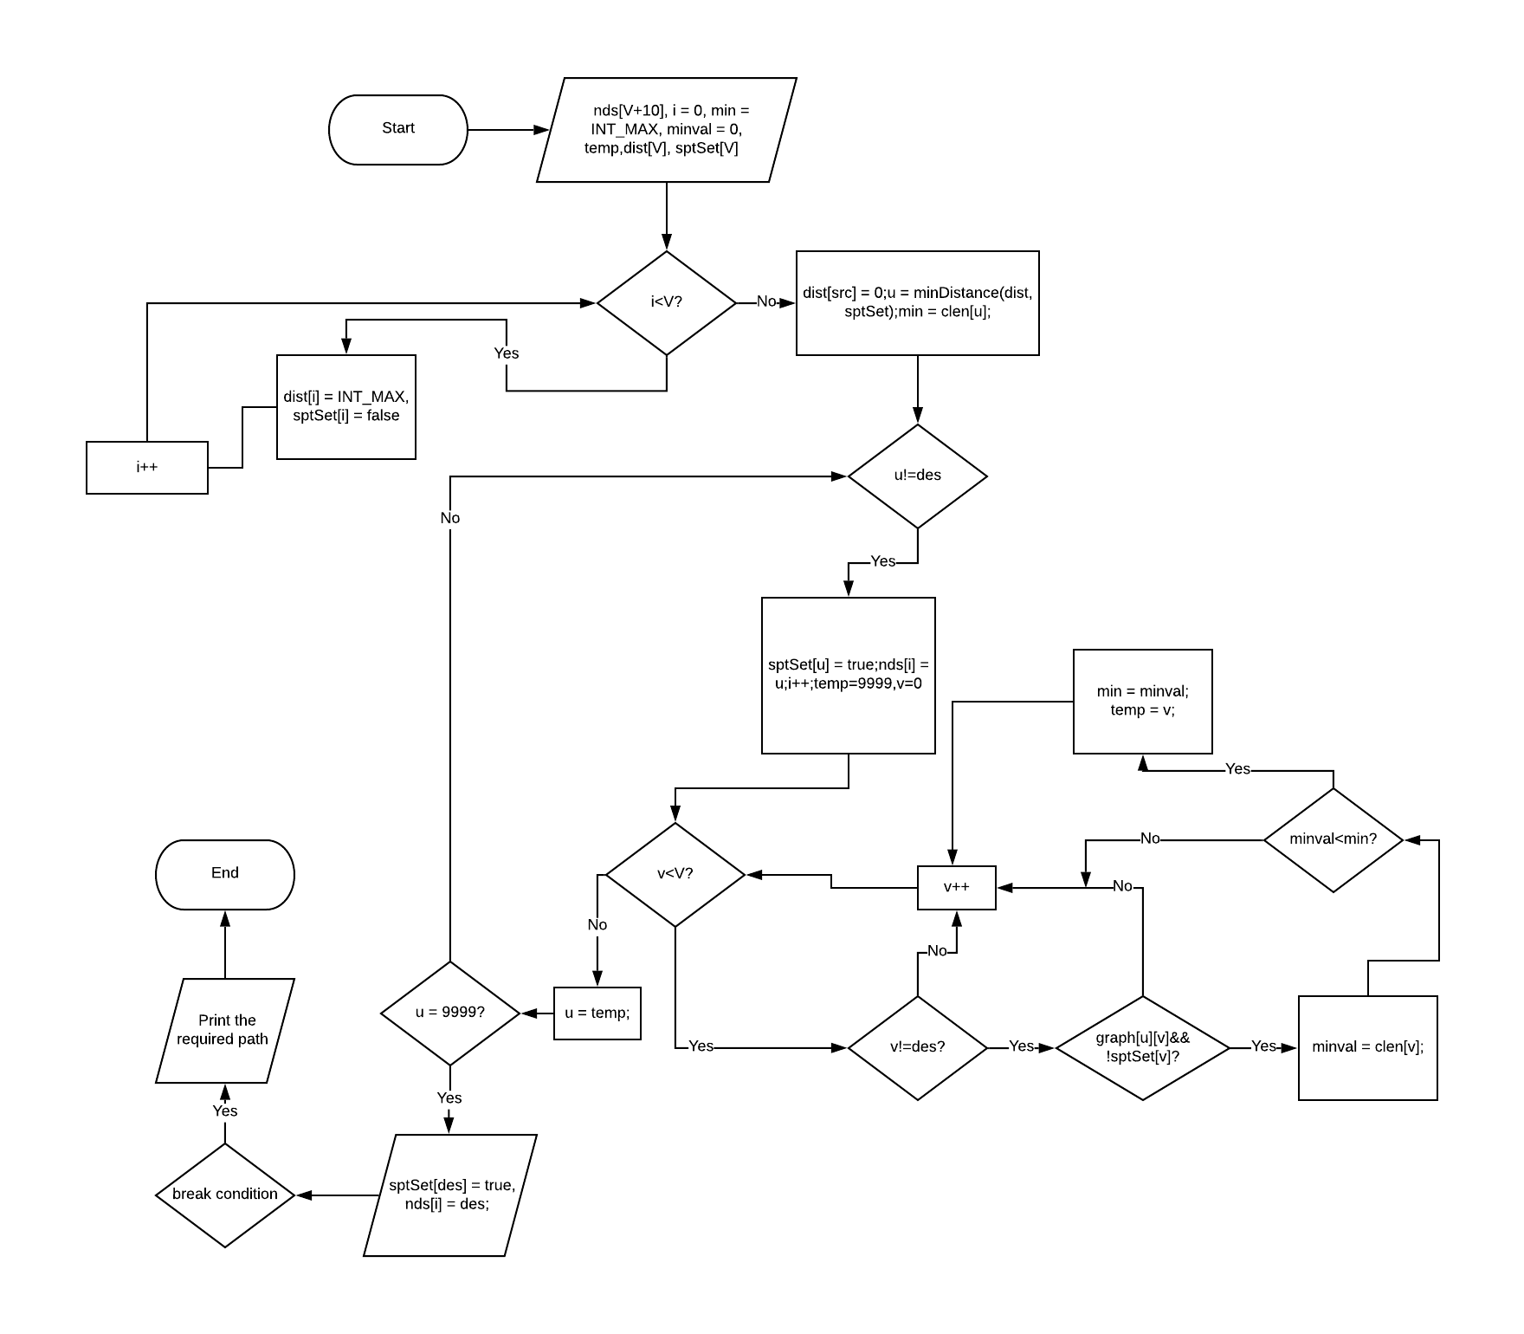
void getSolution(int graph[V][V], int src, int des, int clen[V])

Slide 11
Time Complexity
The time complexity for Dijkstra’s algorithm is O(V²) where V is the number of vertices.
Considering our program and the logic that has been applied, the total worst case time complexity is O(V³).

Slide 12
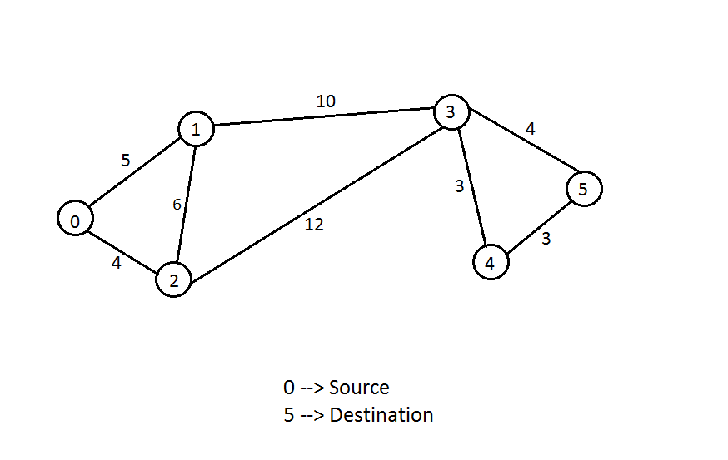
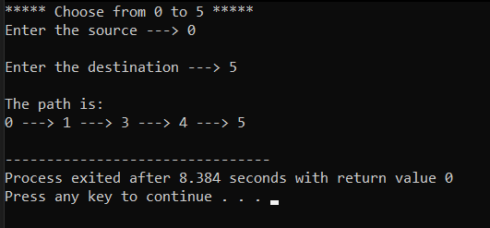
Test Cases
Input
Output

Slide 13
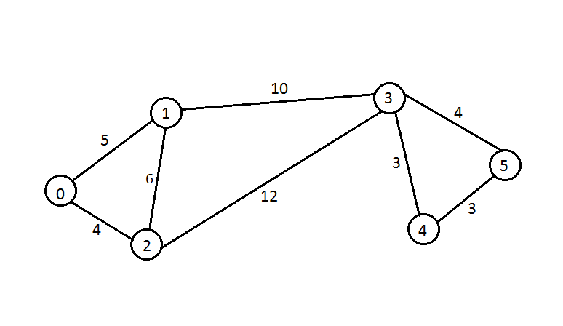
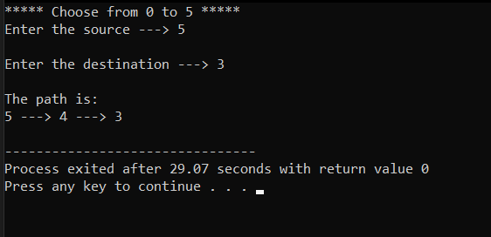
Input
Output

Slide 14
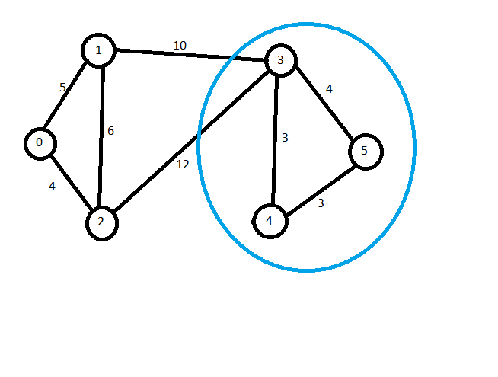
Advantages and disadvantages
The main advantage of our algorithm is that, for every iteration, we find a place which is closer to our destination. Thus, we move towards our target destination at each step.
Referring to our graph, one might point out a particular disadvantage where, if someone is standing at vertex “3”, the destination is directly connected to it and cost is ‘4’.
But, we choose to go to vertex “4”, as it is closer to our destination, though our cost increases.

Slide 15
Opportunities for improvement
By implementing binary heap the complexity of Dijkstra’s algorithm can reduced to O(ELogV)
Using adjacency list representation, all vertices of a graph can be traversed in O(V+E) time using BFS.
Thus reducing the overall complexity to O(EVLogV)

Slide 16
CONCLUSION
We found out an optimal solution to the given problem which could also be implemented in many real-life problems resembling our project.
The project helped us explore the advantages and disadvantages.
In our daily lives, we may unknowingly implement one of the algorithms to solve a problem but may not realize it explicitly.
The project helped us develop some practical ideas which might further nurture our brains to find out something innovative which could benefit a lot of people.

Slide 17
References
https://stackoverflow.com/
https://www.geeksforgeeks.org/
Video lectures from YouTube
https://www.codingame.com/playgrounds/1608/shortest-paths-with-dijkstras-algorithm/dijkstras-algorithm
Fundamentals of Computer Algorithms by Ellis Horowitz

